Slide 1
Searching LinkedIn using Topic Modeling
Team of Moumi Das,Rajarshi Chowdhury,Shiladitya Swarnakar,
Soumya Banerjee,Souvick Datta and Sowmya Kartik
A presentation by Group 4
Data Science Batch of July’19

Slide 2
Our agenda
Introduction
Customer Pain Point
Business Problem
Data Collection
Data preprocessing
Data Modelling
Deployment
Product Marketing
Conclusion

Slide 3
Introduction
0

Slide 4
Our moto:
Just Act
Our goal:
Aiming The ‘Wow’

Slide 5
“Content is King” -Bill Gates
Our 3 months in
2 min.

Slide 6
Let’s do the engineering problem
“Once confined to fantasy and science fiction time travel is simply an engineering problem” - Michio Kaku

Slide 7
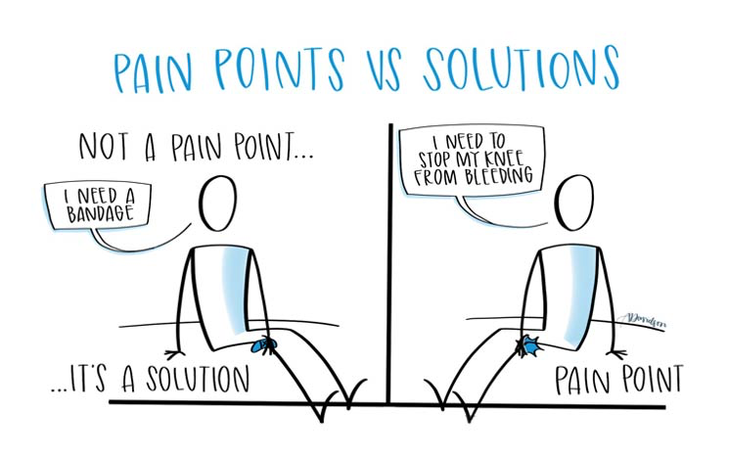

Slide 8
Customer Pain point
“What’s so different about you?”
“My friend told me your product is not good
“Why should I buy your product?”
“Why not that product?”
1
“Why do we need you?”
“Why should we trust you?”
“I have been using that for so long..”
That product costs less!

Slide 9
Reducing asymmetry of information between candidate pool and recruiter pool.

Slide 10
Business Problem
2

Slide 11
4,129$
42 days
Average cost/hire is
To refill a position
Source: According to Human Capital Benchmarking Report by Society for Human Resource Management

Slide 12
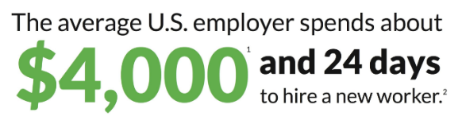
Source: As per GlassDoor , July 5,2019

Slide 13
Understanding the problem
Right resource at the right position can do miracles in business giving
Competitive advantage over other players.
Cost of refilling a position in terms of money and time can be really expensive.
We try to minimize search time at a low cost both for :
A recruiter looking for candidate.
A candidate looking for opportunities.

Slide 14
Data Collection
2

Slide 15
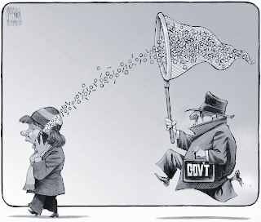
Data Collection?

Slide 16
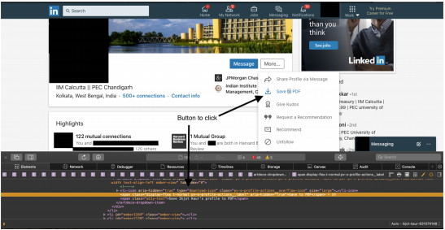
Web Scraping
Extract large amounts of data from websites within a small interval of time.
Data stored in Python Dataframe for analysis

Slide 17
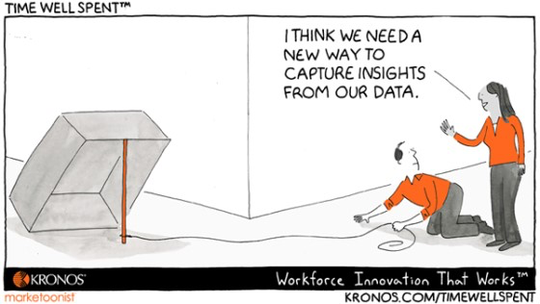
Challenges faced while data collection
P.C. Kronos.com

Slide 18
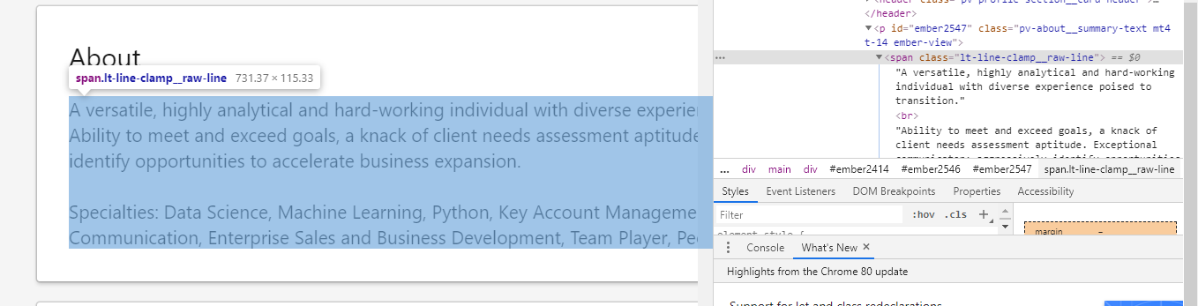
Overcoming the challenge
Scrape data directly from the LinkedIn.
Use inspect element to locate the relevant information.
Approx 5800 public profiles scraped.
Data stored in dataframe

Slide 19
Tools Used
01
Python package used for automated Scraping
Extracts raw web data
SELENIUM
02
Used to refine the text
Used to filter out the HTML tags from raw text
BEAUTIFUL SOUP
All with Python API

Slide 20
Data
Name
Summary
Skills
Experience_1
Current_Organisation
Designation_1
ExpDurationInMonths_1
Designation_2
ExpDurationInMonths_2
Education_1
EduDurationInMonths_1
Education_2
EduDurationInMonths_2
Total_Exp
Total_Education
URL(of Profile)

Slide 21
Data Preprocessing
3

Slide 22
Preprocessing
01
Data extraction from raw data using string manipulation (regex etc.)
DATA CLEANING
02
Text data was broken down into list of words called ‘tokens’.
STOPWORDS were removed
TOKENIZATION
03
Root words were found out for all tokens in the text.
NLTK library is used for lemmatization.
LEMMATIZATION
Notes:
Regular Expressions
Gensim Simple_Preprocess
Spacy Lemmatizer

Slide 23
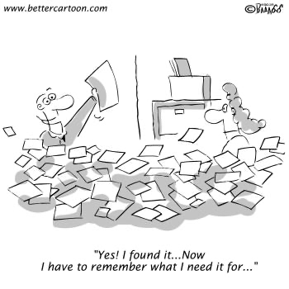
Now what?

Slide 24
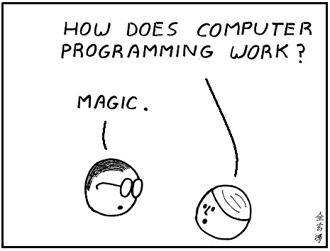
Data Modeling
4

Slide 25
Topic Modelling
Used sklearn’s Latent Dirichlet Allocation(LDA)
Document-Word Matrix was created using CountVectorizer of sklearn
Grid Search Optimization was done to find the best model which was used for profiling

Slide 26
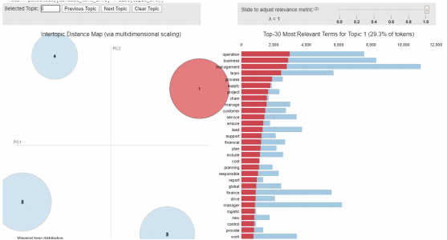
Topic Model Output
-HR
-Marketing
-Operations
-Finance
Result : https://docs.google.com/spreadsheets/d/1-hU40jTwhJu9-Q8BrSmlyihM7aPQ2iAgwAg82awqp_E/edit?usp=sharing

Slide 27
Finding the right profile
Metric used: Jensen-Shannon distance which is the square root of Jensen-Shannon Divergence(JSD).
JS Distance=(JS Divergence)^(½) is a method of measuring the similarity between two probability distributions (documents in this case).
The profiles selected are on the basis of the similarity scores between the query and the selected profile.

Slide 28
Deployment
5

Slide 29
For Integration we used Flask
Requirements?
How we did it?

Slide 30
Our App Navigation
You search, we recommend

Slide 31
Product Marketing
6

Slide 32
Customer since eternity,“Why your product?”
We do the maths, you take the decision!

Slide 33
We don’t believe in 1st,2nd and 3rd because YOU are always 1st!
From the thousands of database, we give you the best search results. Just what you need!
Time:
Each Page visit in Linkedin starting from searching in the search bar takes 10 sec.
For 5 profiles you waste 50 sec. (~ 1min.)
We show the same 5 results in a sec.,in one go. You save time!
Money ? Linkedin and other professional networks are costly . We cost less than Linkedin!
Care about organised data? We organise better. Just what you need!
Summary,Name,Experience, and link to know more all in one page. Not 1 but 5 profiles!

Slide 34
We are a new born but we have answers to your “How?”

Slide 35
Initially want to use push strategy for product awareness.
Segmentation /Target Group:
Primary TG: SMEs who can’t afford costly recruitment softwares like Linkedin Lite, Naukri premium etc.
Secondary TG: Candidates ( mostly students) who want to get in touch with people of a particular domain.
Remember all those random texts from random people asking for opinions about an institute , career path etc!! Quora here we come!
Strategy:
Primary Target Group: SMEs and other organisations | Purpose: Revenue earner, partially product awareness.
Secondary Target Group: Students. <verify students> | Purpose: Primarily product awareness. Not to be used for revenue.

Slide 36
Revenue Model: (Initially till product captures a certain market size)
Promotion: YouTube ads, Popular web series tie-ups,WOM, our revenue model itself for promotion.
Competitors: We consider Linkedin our primary competitor- high brand loyalty of users! Besides there are Zoho,Social Recruiting,New radius Search etc.
Primary Revenue Earner | SMEs, other organisations
Secondary Revenue Earner | Nil

Slide 37

A needle in a haystack for an MVP and I have read “miles to go before I sleep..”
We found a customer
who have shown interest in our product!
Yups a ‘Partner’.
Eeeaahhh!
P.C 35greeting.com

Slide 38
Pricing
5
Competitors | Plans available(Rs) | Pricing (Rs/month) | Nos. of profiles allowed to visit
Linkedin Recruiter | 68840/year | 5736.666667 | Unlimited
Linkedin Recruiter Lite | 9180.97/per month | 9180.97 | Unlimited
Zoho | 1350/month/user | 1350 | Unlimited
Naukri | 83000/3 months | 27666.66667 | 7000
Planning a penetration pricing initially.Freemium.
Later on we can make difference in pricing one Basic another Advanced.

Slide 39
Conclusion
7

Slide 40

Step-I :
What’s the story so far?

Slide 41

Step-II Limitations?

Slide 42
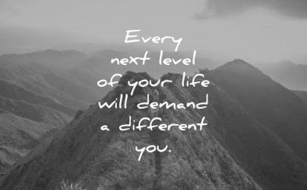
Step-III :
So what next?

Slide 43
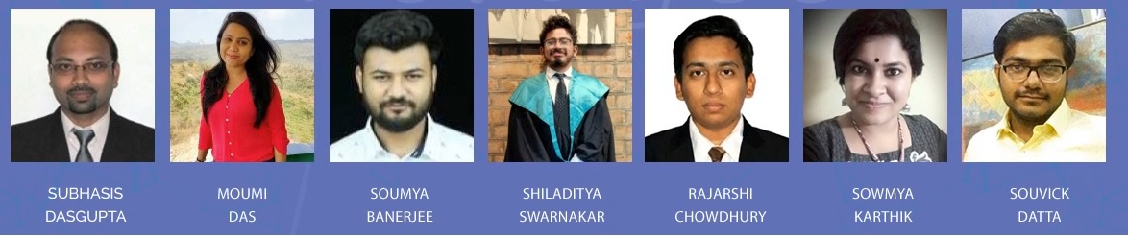
We at Forage

Slide 44
Reference Links:
https://www.glassdoor.com/employers/blog/calculate-cost-per-hire/
https://www.shrm.org/hr-today/trends-and-forecasting/research-and-surveys/Documents/2016-Human-Capital-Report.pdf
https://en.wikipedia.org/wiki/Jensen%E2%80%93Shannon_divergence
https://www.cs.princeton.edu/~runzhey/demo/Topic_Models_I.pdf

Slide 45
Thank you

Slide 46
Any Questions?

